Slide 1
JUnit Testing

Slide 2
What is unit testing?
Unit testing is testing of a small logic or a code to verify that the output of the code is as expected on the input of a specific data and/or on satisfying certain condition(s). Usually, the unit tests are supposed to be independent of the other tests.
Unit tests are not feasible to test complex interfaces with another application or third party/external services. A unit test targets only a small unit of code that could be just a method or a class.
It helps the developer discover issues in the current logic and any regression failures due to the current change. Besides, it also provides insight into how the current code could impact future implementation.

Slide 3
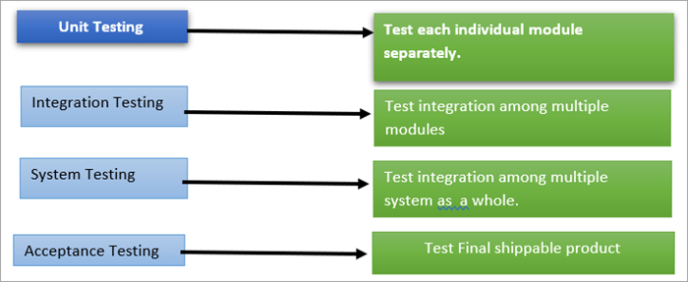

Slide 4
Objective of Unit Testing:
The objective of Unit Testing is:
To isolate a section of code.
To verify the correctness of the code.
To test every function and procedure.
To fix bugs early in the development cycle and to save costs.
To help the developers to understand the code base and enable them to make changes quickly.
To help with code reuse.

Slide 5
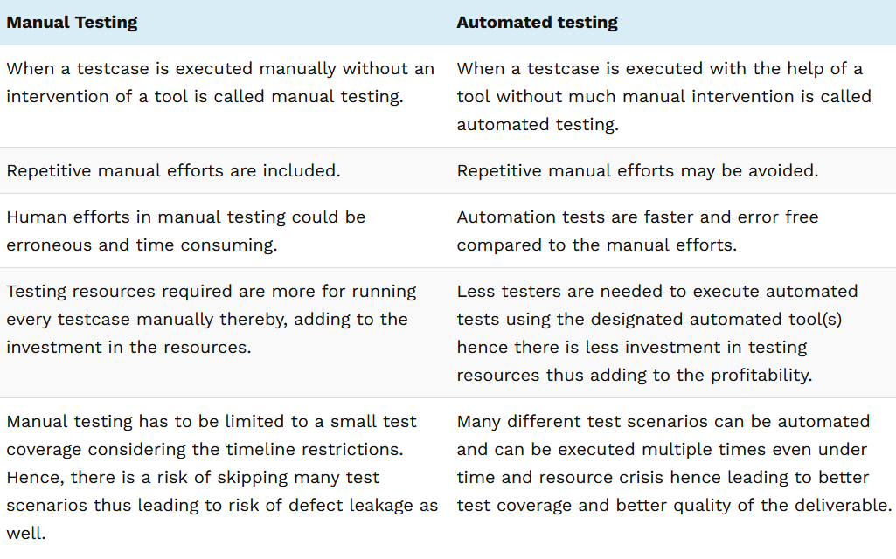
Types of Unit Testing:
There are 2 types of Unit Testing: Manual, and Automated.

Slide 6
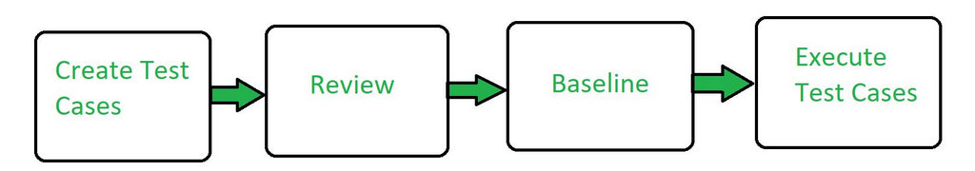
Workflow of Unit Testing:

Slide 7
Advantages of Unit Testing:
Unit Testing allows developers to learn what functionality is provided by a unit and how to use it to gain a basic understanding of the unit API.
Unit testing allows the programmer to refine code and make sure the module works properly.
Unit testing enables testing parts of the project without waiting for others to be completed.
Early Detection of Issues: Unit testing allows developers to detect and fix issues early in the development process, before they become larger and more difficult to fix.
Improved Code Quality: Unit testing helps to ensure that each unit of code works as intended and meets the requirements, improving the overall quality of the software.

Slide 8
Increased Confidence: Unit testing provides developers with confidence in their code, as they can validate that each unit of the software is functioning as expected.
Faster Development: Unit testing enables developers to work faster and more efficiently, as they can validate changes to the code without having to wait for the full system to be tested.
Better Documentation: Unit testing provides clear and concise documentation of the code and its behavior, making it easier for other developers to understand and maintain the software.
Facilitation of Refactoring: Unit testing enables developers to safely make changes to the code, as they can validate that their changes do not break existing functionality.
Reduced Time and Cost: Unit testing can reduce the time and cost required for later testing, as it helps to identify and fix issues early in the development process.

Slide 9
Disadvantages of Unit Testing:
The process is time-consuming for writing the unit test cases.
Unit Testing will not cover all the errors in the module because there is a chance of having errors in the modules while doing integration testing.
Unit Testing is not efficient for checking the errors in the UI(User Interface) part of the module.
It requires more time for maintenance when the source code is changed frequently.
It cannot cover the non-functional testing parameters such as scalability, the performance of the system, etc.
Time and Effort: Unit testing requires a significant investment of time and effort to create and maintain the test cases, especially for complex systems.

Slide 10
Dependence on Developers: The success of unit testing depends on the developers, who must write clear, concise, and comprehensive test cases to validate the code.
Difficulty in Testing Complex Units: Unit testing can be challenging when dealing with complex units, as it can be difficult to isolate and test individual units in isolation from the rest of the system.
Difficulty in Testing Interactions: Unit testing may not be sufficient for testing interactions between units, as it only focuses on individual units.
Difficulty in Testing User Interfaces: Unit testing may not be suitable for testing user interfaces, as it typically focuses on the functionality of individual units.
Over-reliance on Automation: Over-reliance on automated unit tests can lead to a false sense of security, as automated tests may not uncover all possible issues or bugs.
Maintenance Overhead: Unit testing requires ongoing maintenance and updates, as the code and test cases must be kept up-to-date with changes to the software.

